Slide 1
Data Structures: Search Trees
Computer Science, Purdue University
Copyright WILEY, Goodrich and Tamassia, Data Structures And Algorithms

Slide 2
Search Trees
Binary Search Trees
Binary Search Trees
AVL Trees
Computer Science, Purdue University

Slide 3
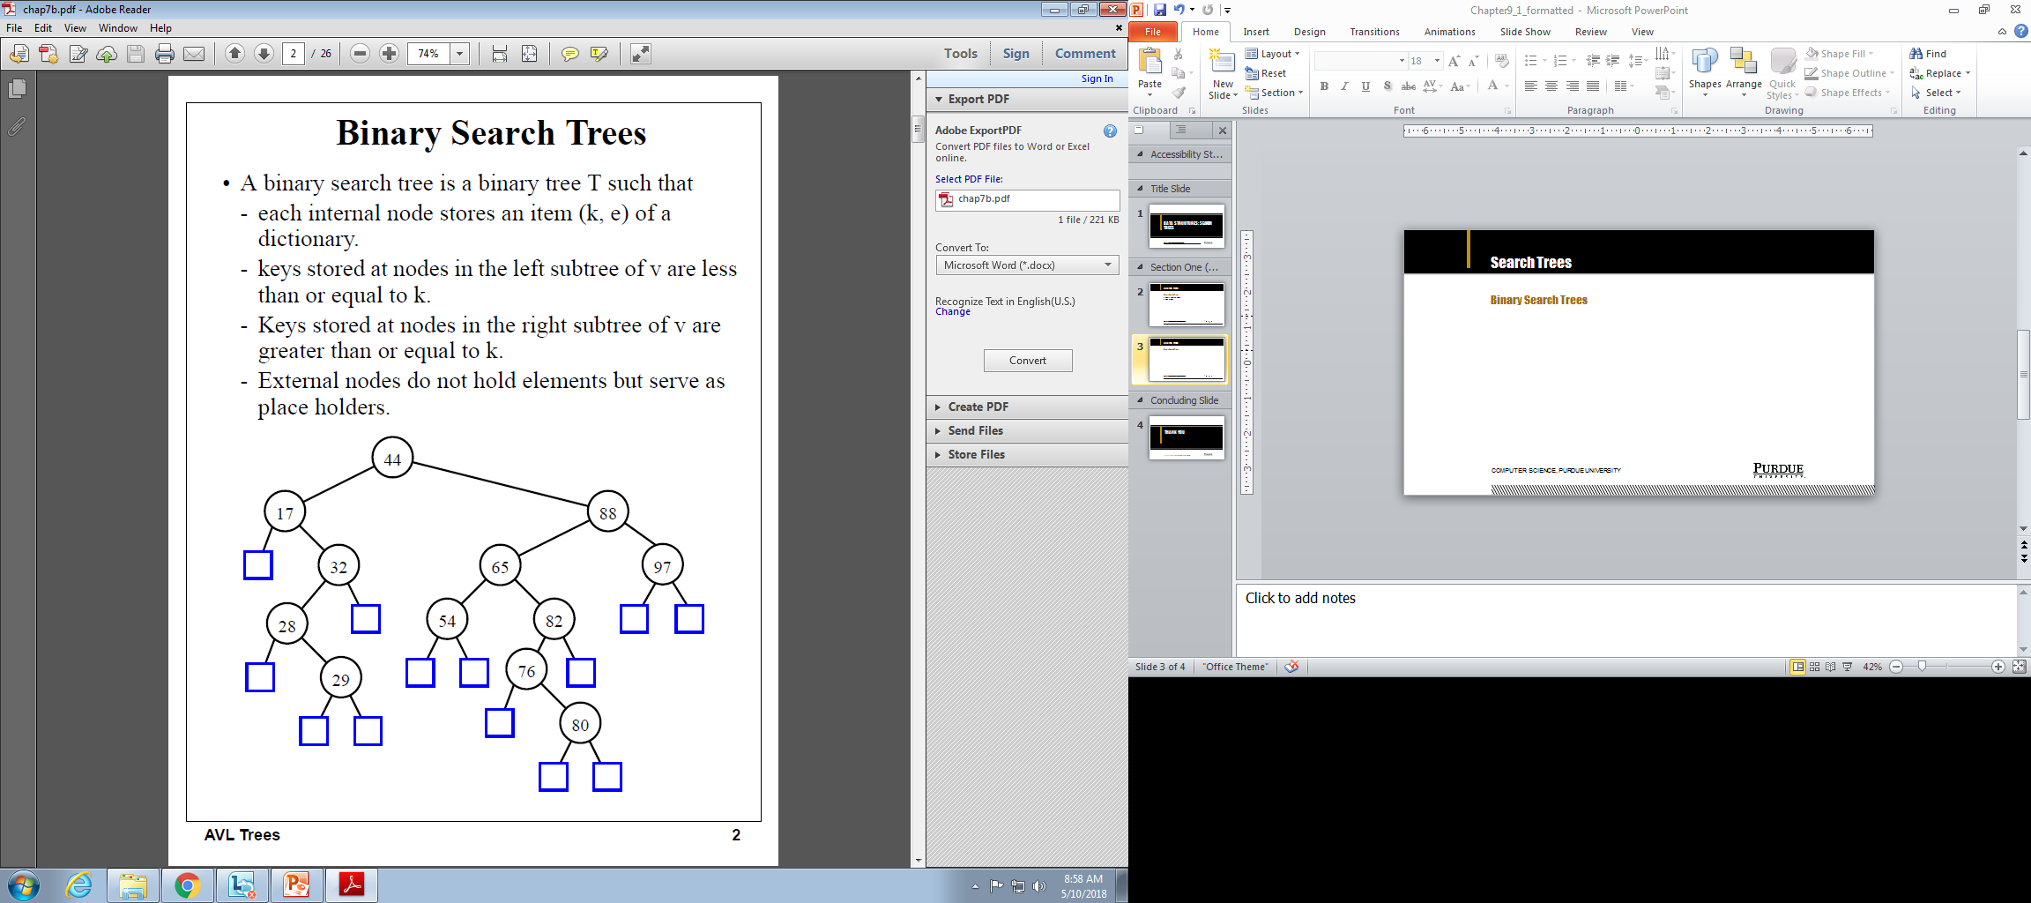
Search Trees
Binary Search Trees
Computer Science, Purdue University

Slide 4
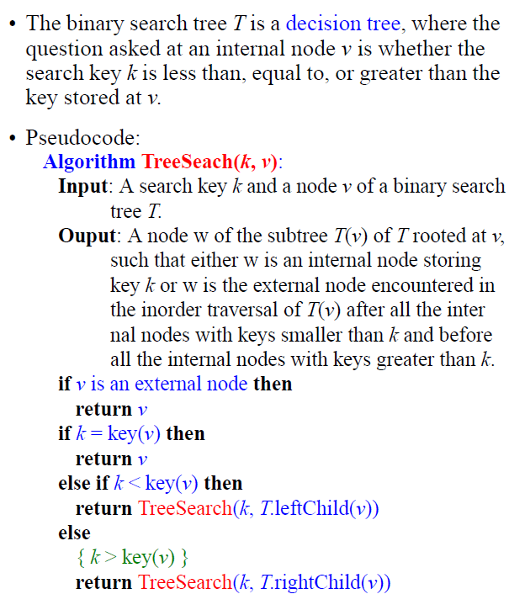
Search Trees
Binary Search Trees
Computer Science, Purdue University

Slide 5
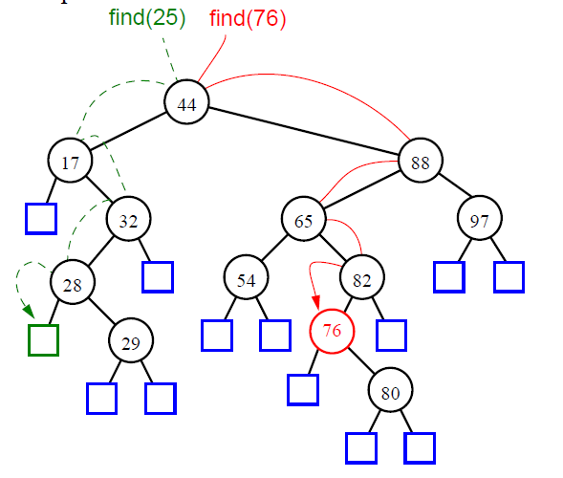
Search Trees
Binary Search Trees
Computer Science, Purdue University

Slide 6
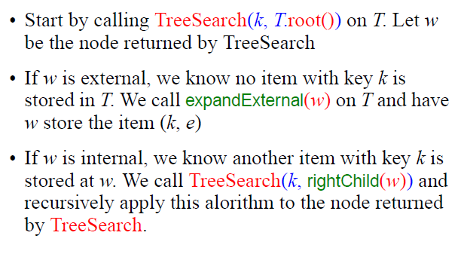
Search Trees
Binary Search Trees:
Insertion
Computer Science, Purdue University

Slide 7
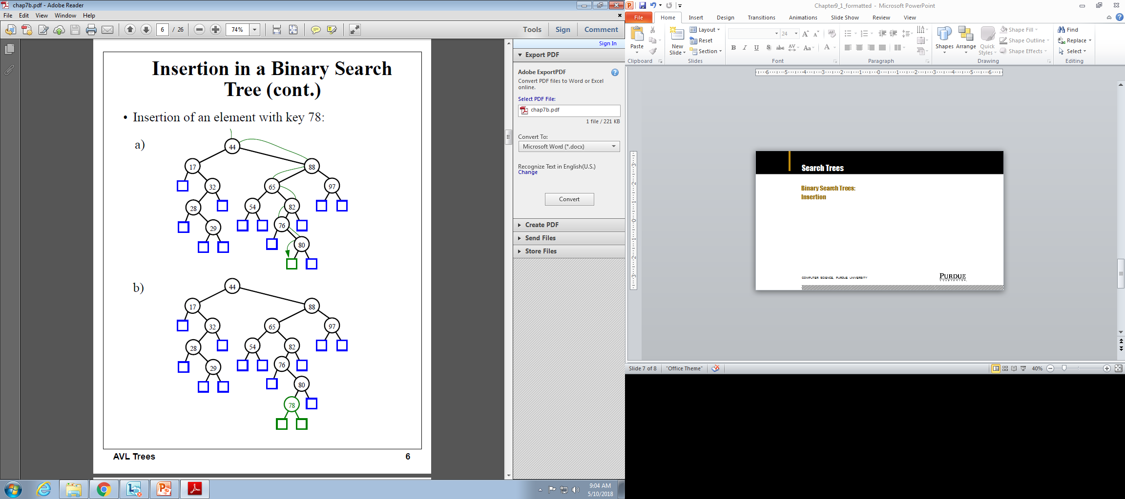
Search Trees
Binary Search Trees:
Insertion
Computer Science, Purdue University

Slide 8
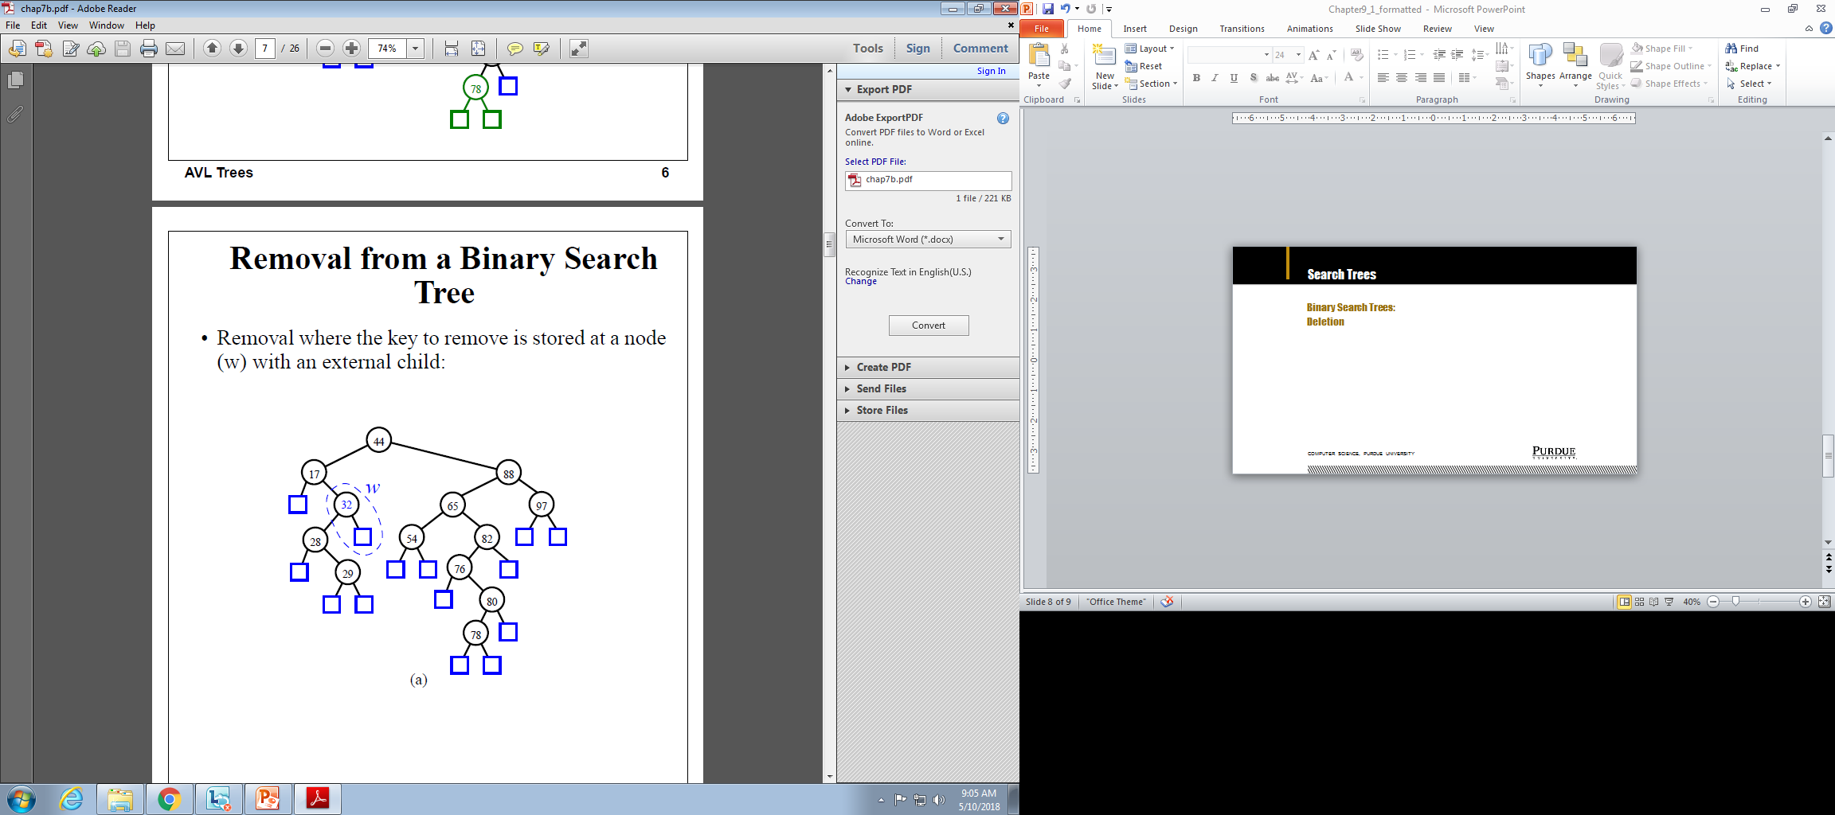
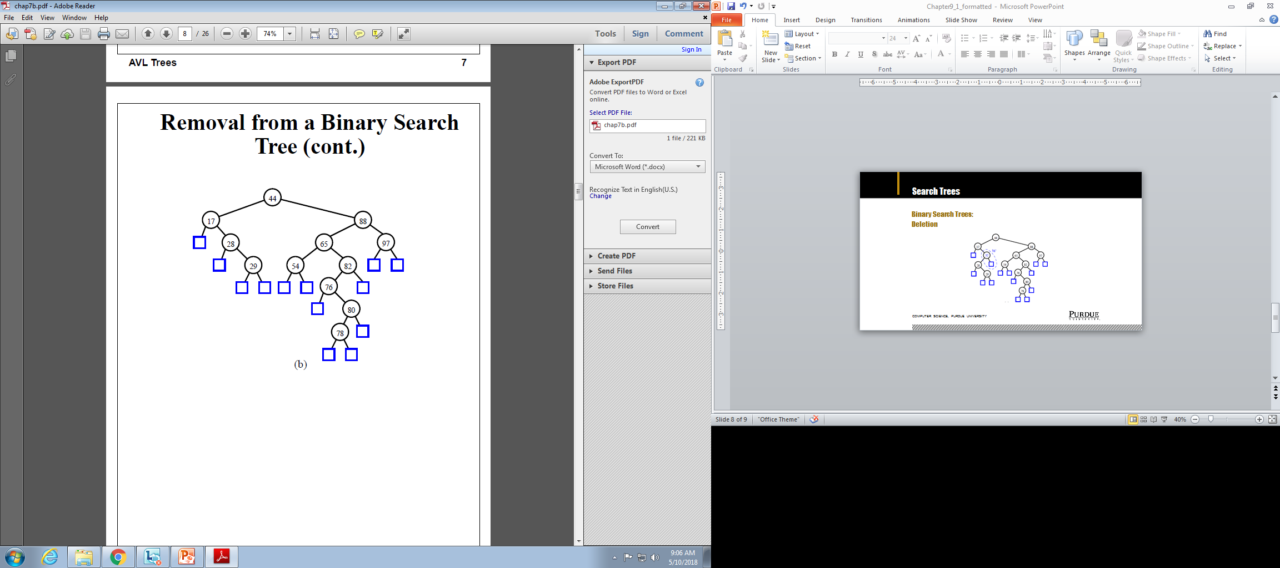
Search Trees
Binary Search Trees:
Deletion
Computer Science, Purdue University

Slide 9
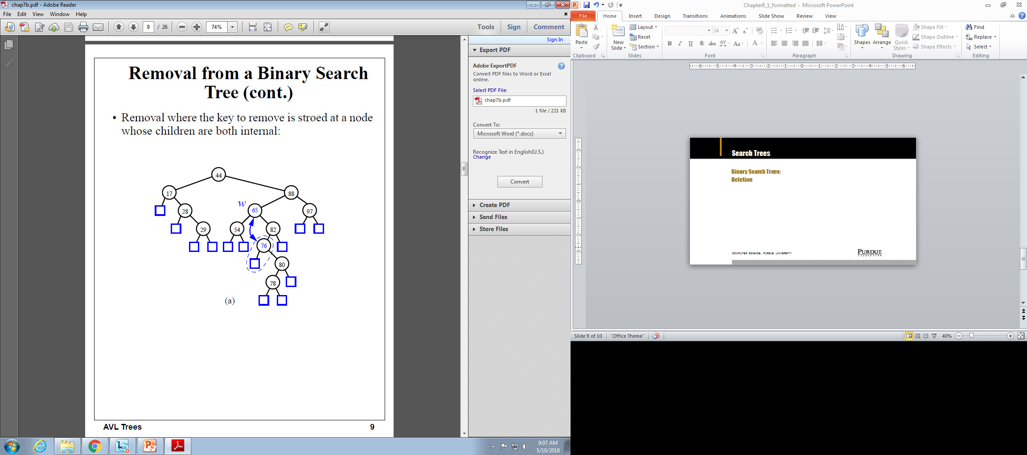
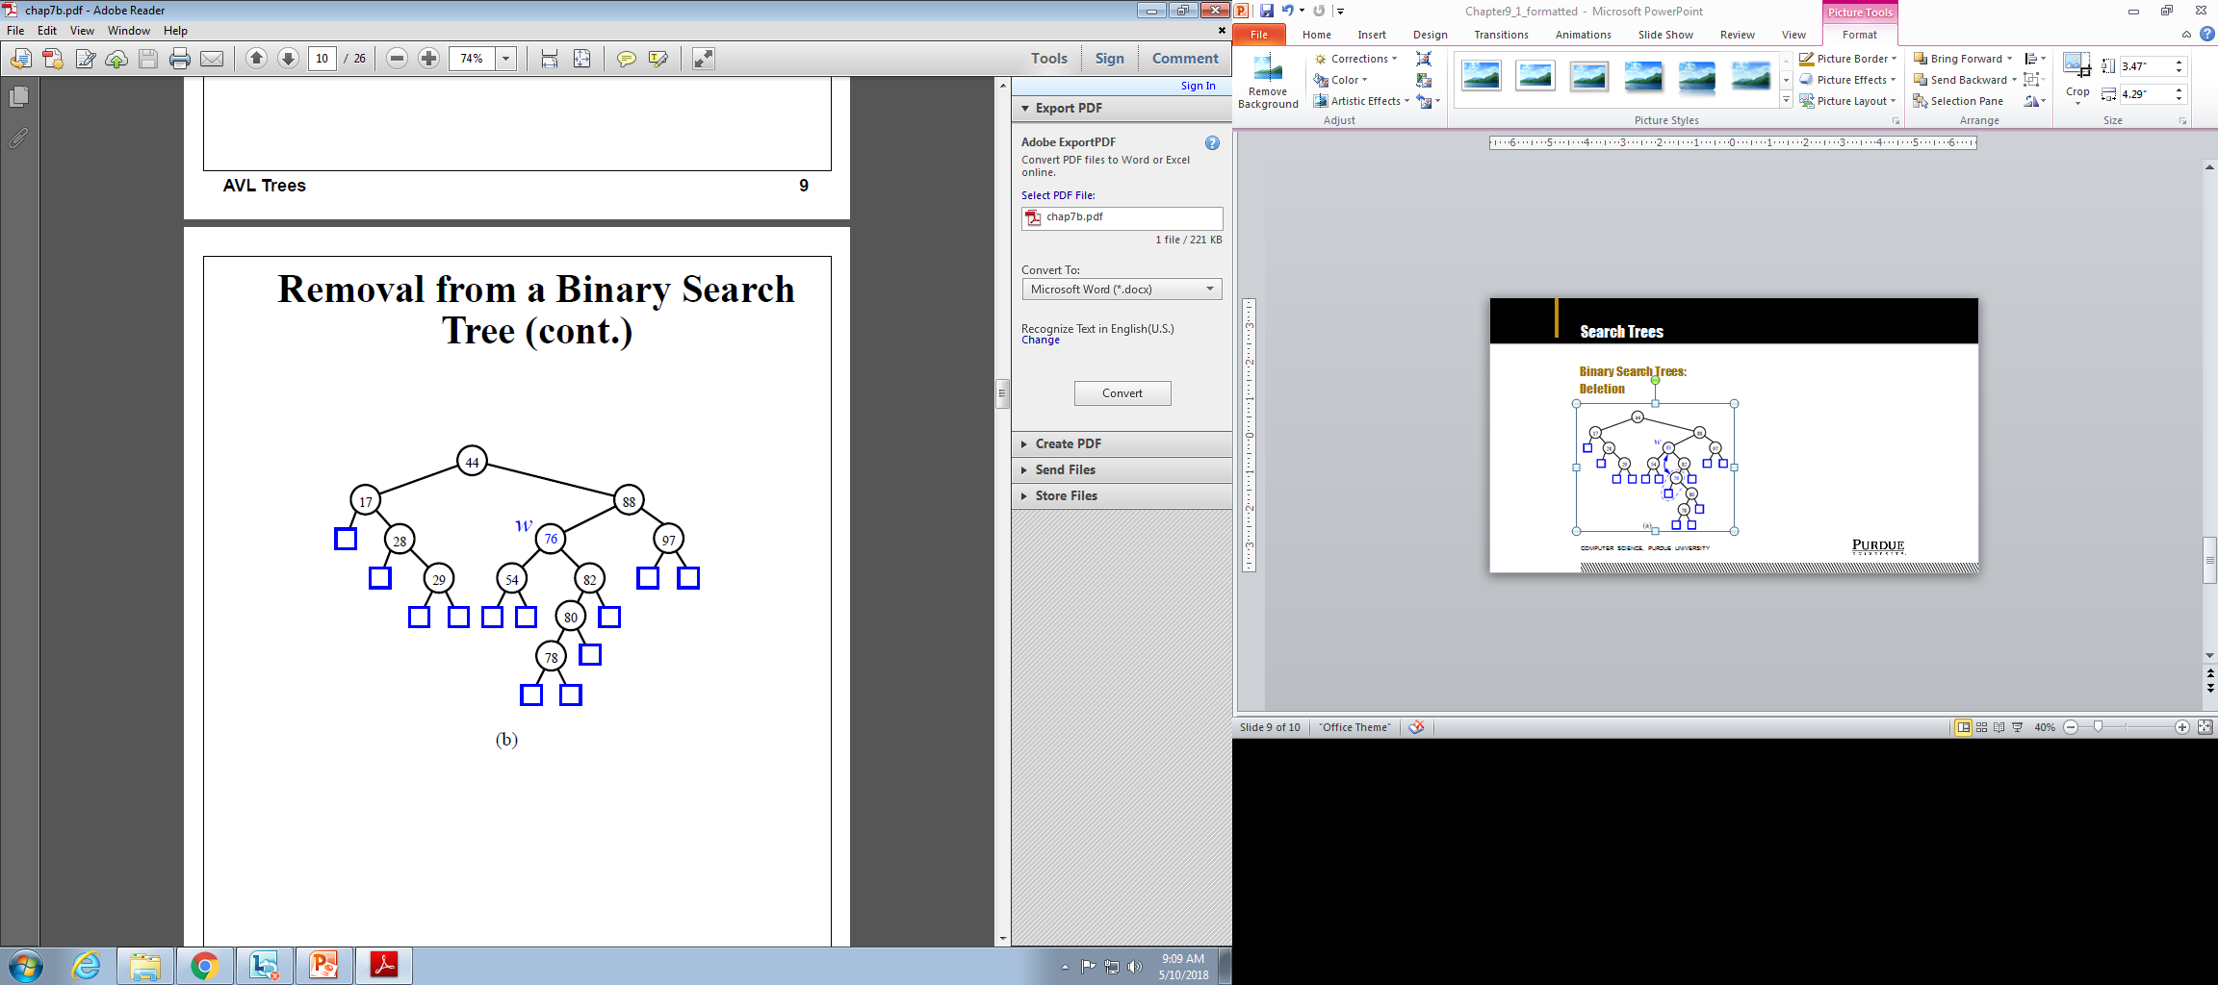
Search Trees
Binary Search Trees:
Deletion
Computer Science, Purdue University

Slide 10

Search Trees
Binary Search Trees: Time Complexity
Computer Science, Purdue University

Slide 11
Thank You

